Slide 1
Features of OOP (Classes and Objects) Md. Alamgir Hossain Lecturer, State University of Bangladesh Mail: alamgir.cse14.just@gmail.com

Slide 2
Classes and Objects
Class: A class in C++ is the building block, that leads to Object-Oriented programming.
It is a user-defined data type, which holds its own data members and member functions, which can be accessed and used by creating an instance of that class.
A C++ class is like a blueprint for an object.
Example: Consider the Class of Cars. There may be many cars with different names and brand but all of them will share some common properties like all of them will have 4 wheels, Speed Limit, Mileage range etc. So here, Car is the class and wheels, speed limits, mileage are their properties.

Slide 3
Classes and Objects
Object is an instance of a Class.
When a class is defined, no memory is allocated but when it is instantiated (i.e. an object is created) memory is allocated.
Example: Honda, Toyota, BMW(Bayerische Motoren Werke) etc.

Slide 4
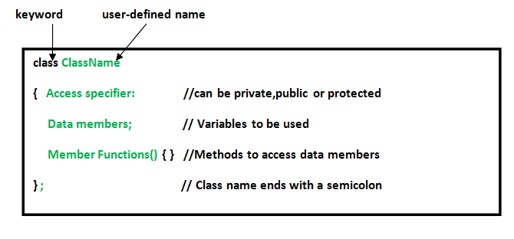
Defining Class and Declaring Objects
A class is defined in C++ using keyword class followed by the name of class. The body of class is defined inside the curly brackets and terminated by a semicolon at the end.

Slide 5
Defining Class and Declaring Objects
Declaring Objects: When a class is defined, only the specification for the object is defined; no memory or storage is allocated.
To use the data and access functions defined in the class, you need to create objects.
Syntax: ClassName ObjectName

Slide 6
Accessing Data Members and Member Functions
The data members and member functions of class can be accessed using the dot(‘.’) operator with the object.
For example if the name of object is obj and you want to access the member function with the name printName() then you will have to write obj.printName() .
Accessing a data member depends solely on the access control of that data member.
There are 3 types of access modifiers available in C++: Public, Private, Protected

Slide 7
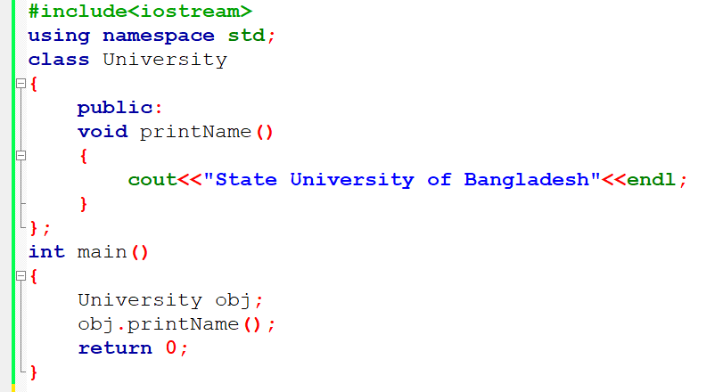
Defining Class and Declaring Objects

Slide 8
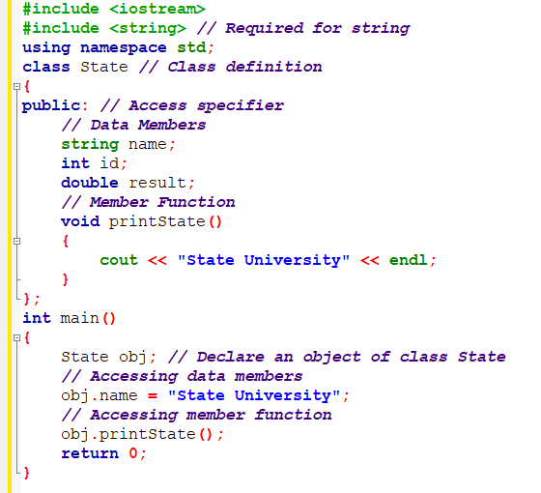
Defining Class and Declaring Objects

Slide 9
Member Functions in Classes
There are 2 ways to define a member function:
Inside class definition, Outside class definition
To define a member function outside the class definition we have to use the scope resolution :: operator along with class name and function name.

Slide 10
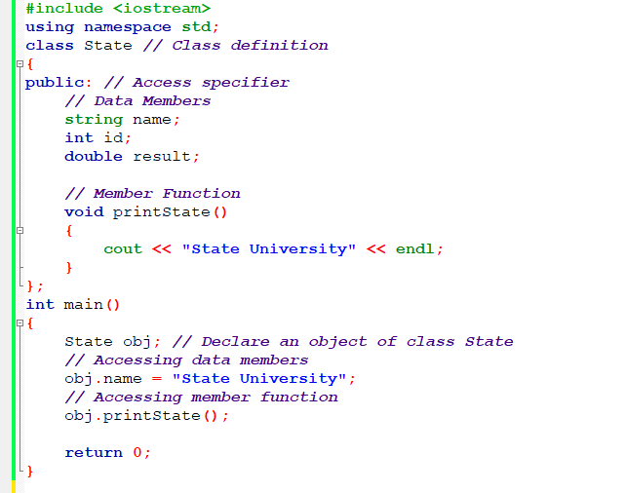
Member Functions in inside Class

Slide 11
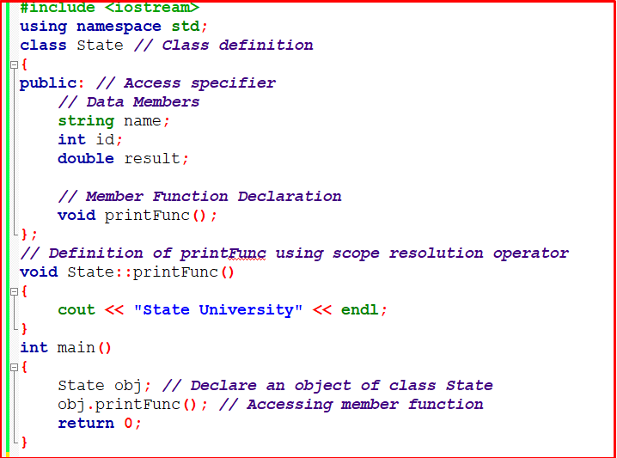
Member Functions in outside Class

Slide 12
Thank You

